Slide 1
Data Incognita:
Digital Scriptorium in a Semantic Web Context
March 8, 2024
Notes:
Welcome to a tour of the Digital Scriptorium! Strap in.

Slide 2
Introduction
Thanks to:
L.P. Coladangelo
Lynn Ransom
Doug Emery
Mace Jones (co-fellow)
Jade Snelling
Special Collections and University Archives
Virginia Tech
2023 LEADING Fellow
Notes:
Introduce self
What is LEADING? LIS (Library and Information Science) Education And Data science Integrated Network Group
My work was made possible by the guidance of L.P., Lynn, and Doug, who advised me, encouraged me, and connected me with resources throughout this project. Special thanks to L.P., who is a SPARQL master and former LEADING fellow himself. Thanks to my co-fellow, Mace, who took an entirely different approach to the DS data and enriched my fellowship experience.

Slide 3
Presentation Roadmap
Putting manuscript data to work
Redevelopment
Developing documentation and use cases
Different representations of the same thing
Can we map to other models to query across datasets?
Mapping considerations and standards
Mapping observations
Final takeaways and areas for future research
Notes:
What can you expect to get out of this presentation? First, I want to talk about Digital Scriptorium’s redevelopment as a linked open data union catalog, and give important background on modeling considerations and the chosen hosting platform, Wikibase. Then I want to give a quick rundown of the WDQS, a SPARQL endpoint that allows you to query against DS/Wikidata, and how working with queries led me back to the data model.
In the second half of the presentation I’ll be talking about my adventures with “semantic” mapping and ontology alignment - the purpose of which is to support even broader data integration and querying across datasets. During this portion there will be a lot of technical jargon, but I’m hoping that between explicitly defining my terms and context clues you should be able to follow the work.
Finally I’ll talk about my final takeaways as well as what was out-of-scope for my project but may be worth researching in the future.

Slide 4
Digital Scriptorium Redevelopment
Notes:
https://search.digital-scriptorium.org/

Slide 5
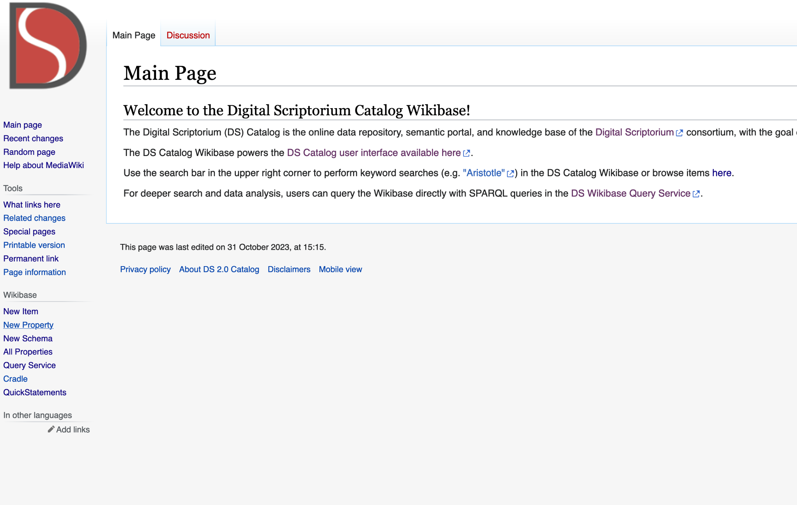
Powered by Wikibase
https://catalog.digital-scriptorium.org/wiki/Main_Page

Slide 6
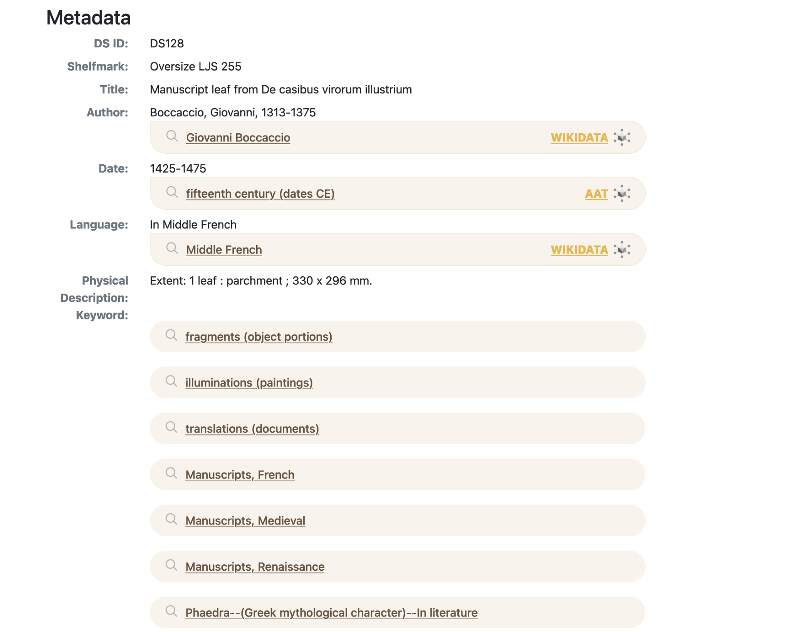
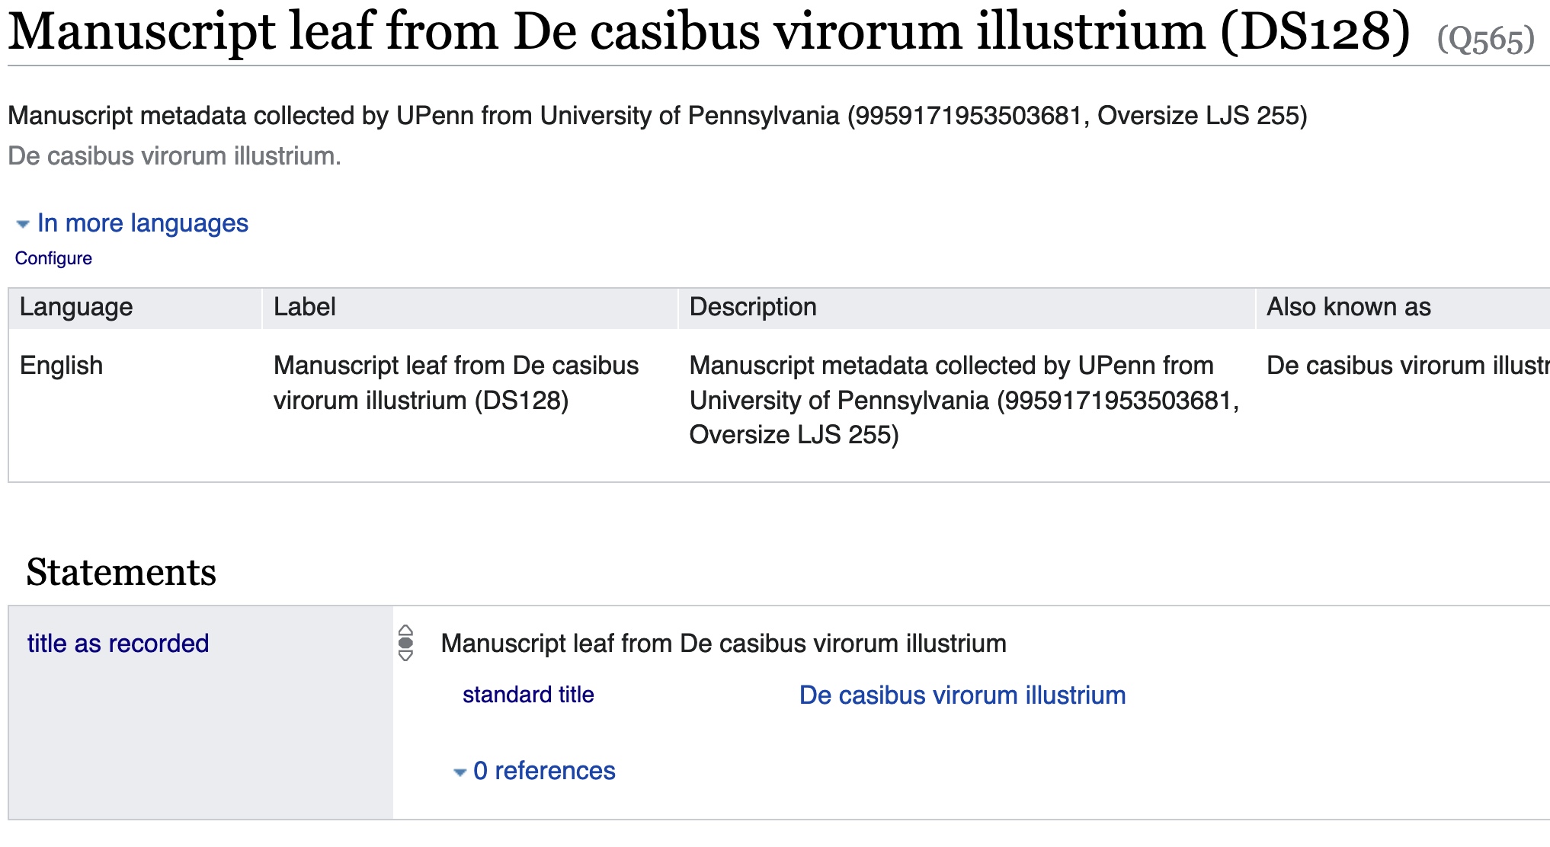
Metadata: The Catalog Interface vs. Wikibase
https://search.digital-scriptorium.org/catalog/DS128

Slide 7
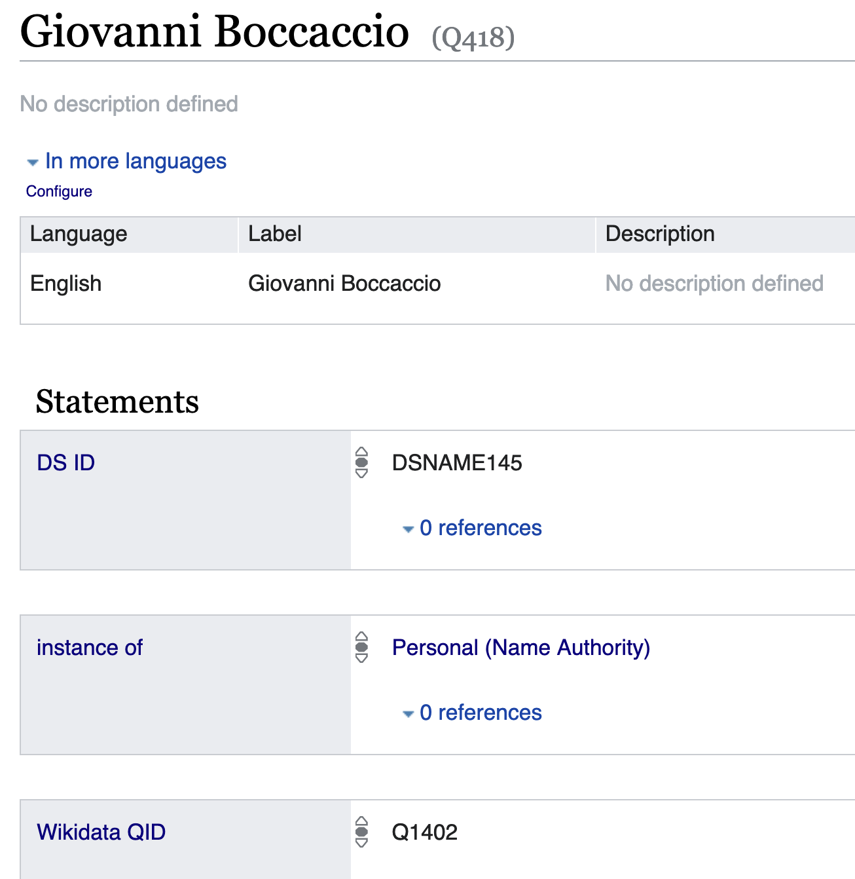
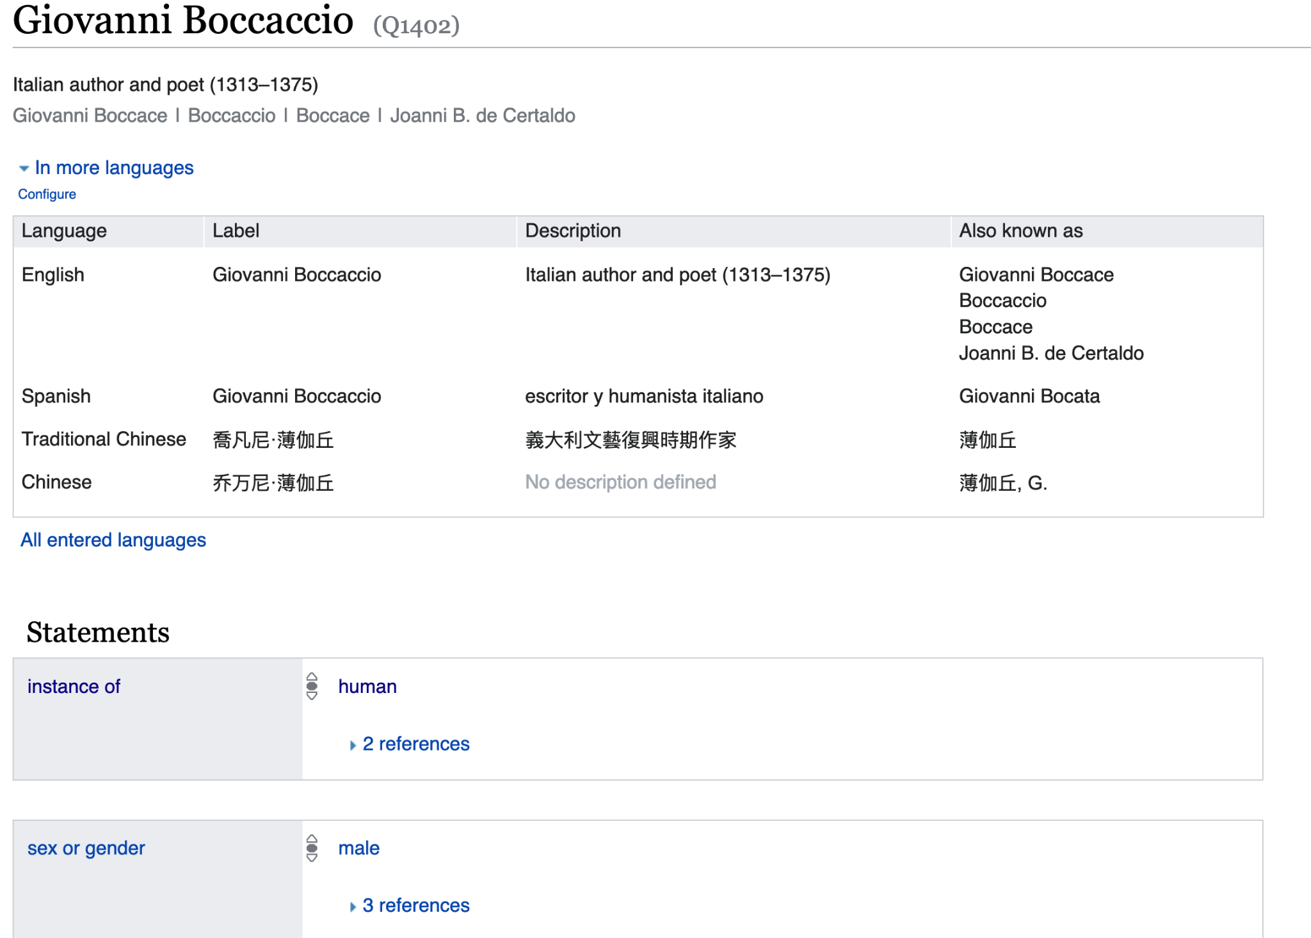
Name authorities in Wikibase

Slide 8
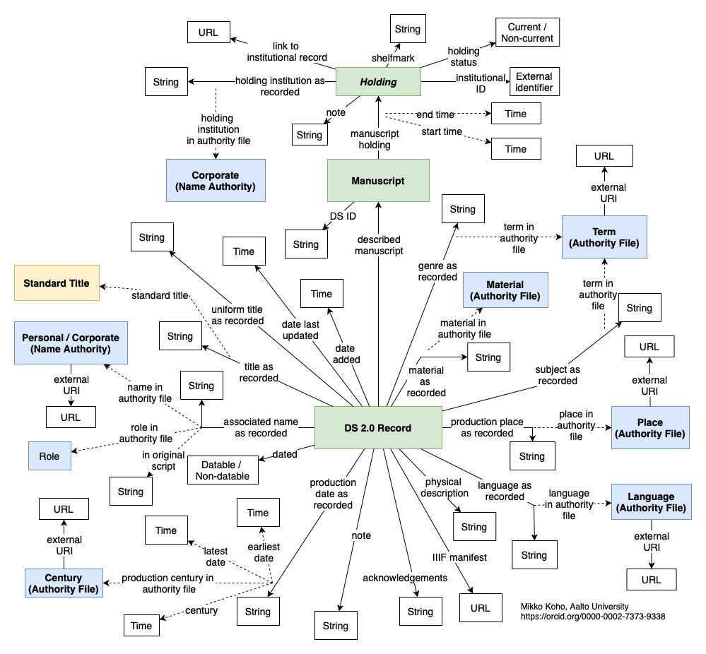
Data Model as Implemented in Wikibase
Classes and items
Properties
Qualifiers
Wikibase data types
Notes:
What if we had documentation that captured these modeling relationships that also indexed every property and entity to its identifier (P or QID), their definitions, and usage constraints?

Slide 9
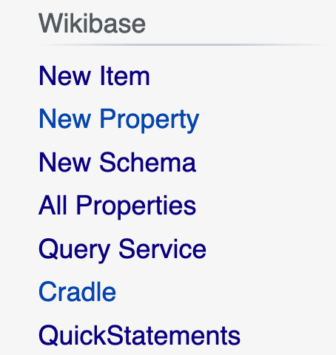
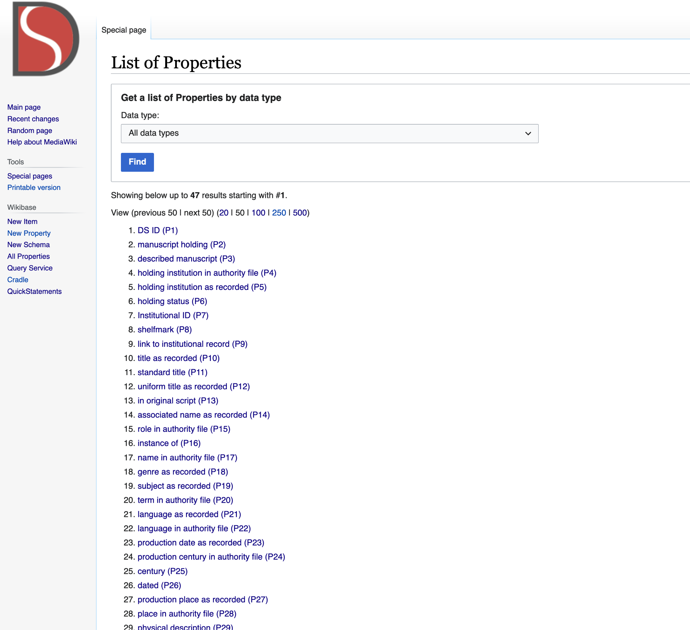
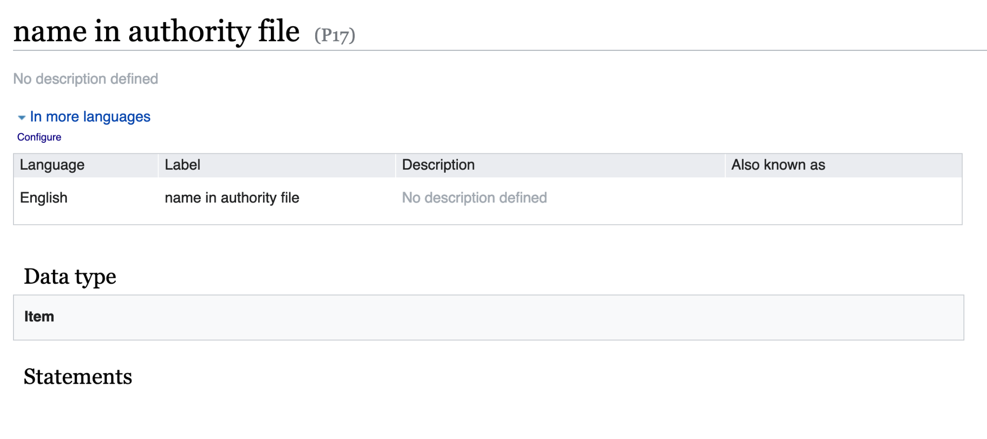
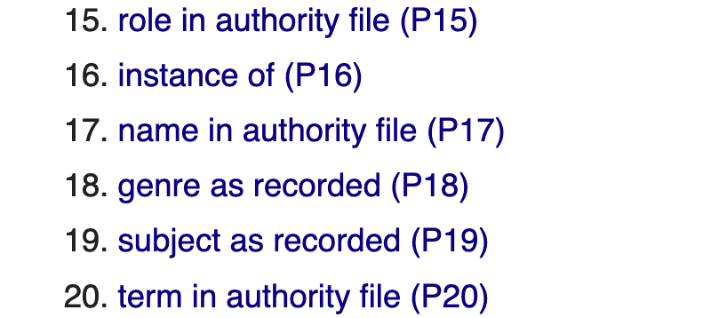
Properties and Qualifiers
Notes:
I know this page looks busy, but I have a few zoomed-in insets to aid in readability, breadcrumbing navigation

Slide 10
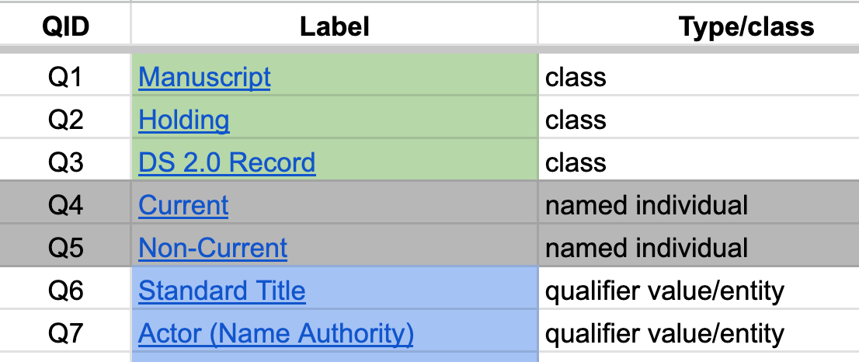
Tabular Model:
Entities
Notes:
Tables - easy to curate, easy to analyze…

Slide 11
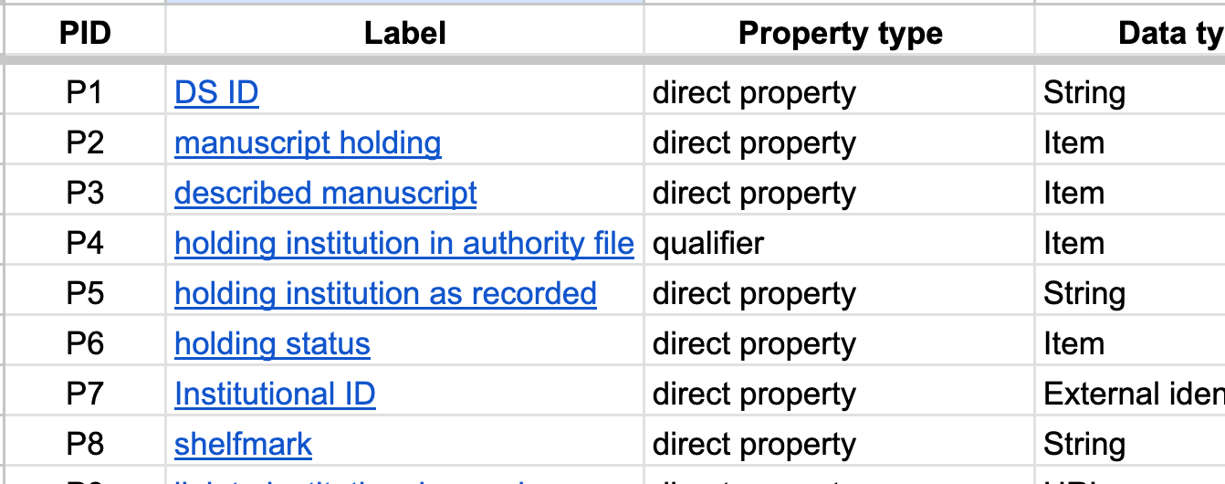
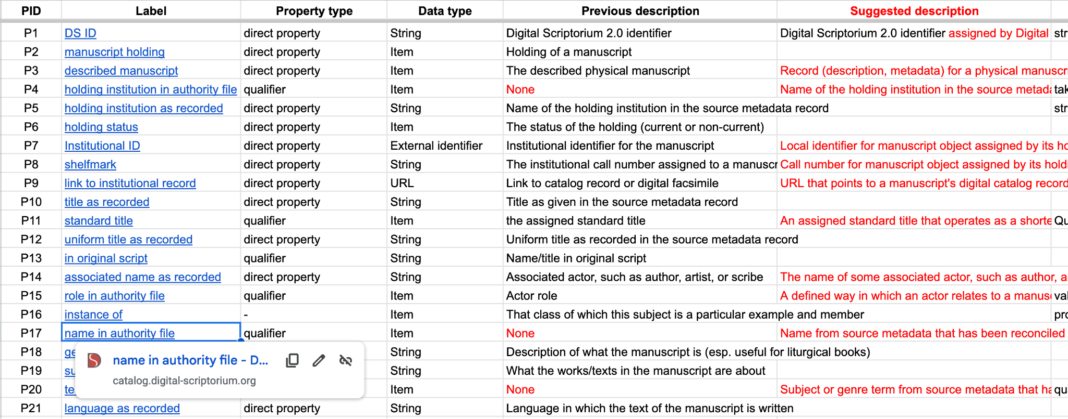
Tabular Model:
Properties

Slide 12
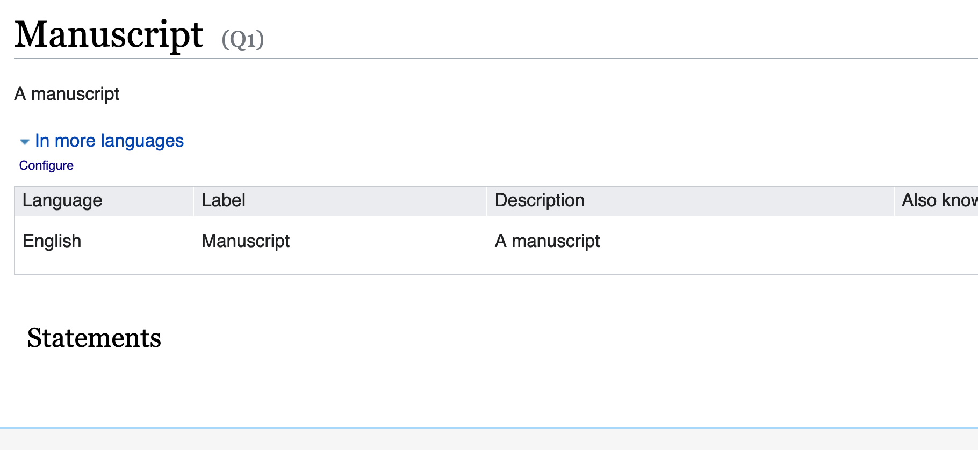
Denotative meaning
Notes:
https://catalog.digital-scriptorium.org/wiki/Item:Q1
Item’s denotative meaning - item’s structural meaning (how is it used in the context of the model??

Slide 13
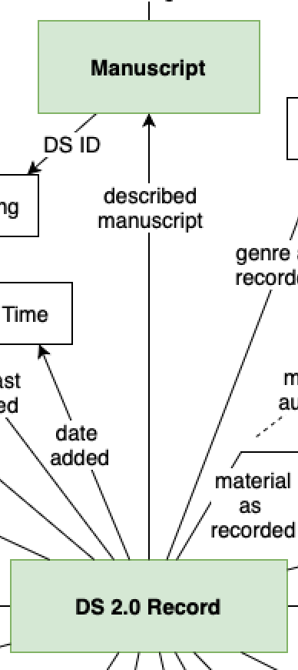
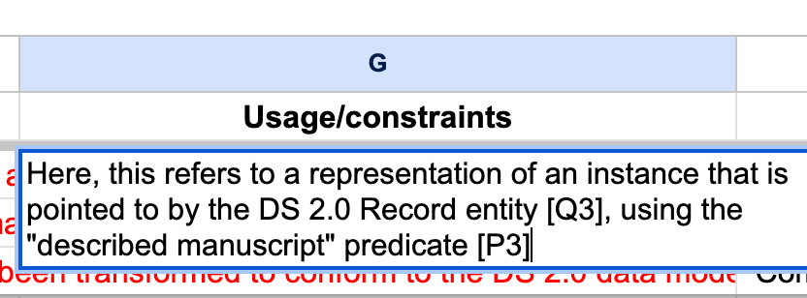
Structural meaning and usage constraints

Slide 14
What happens if we map entities to other models?
Notes:
Introduction to semantic web technologies.
Allows for creative recombination of partial, decentralized descriptions?

Slide 15
Models in conversation
Medieval Manuscript Ontology
Europeana Data Model
MeMO
EDM
Digital Scriptorium Model
specializes
IMAGO
CRM
(is aligned with)
Index Medii Aevi Geographice Operum
Conceptual Reference Model
Notes:
Old notes: There are more, of course, but with limited time to explore semantic mapping I focused my efforts on these few and just dip my toe in. Other more generic ontologies came to mind (DC, FRBRoo, FOAF), but some of the above ontologies are sometimes already aligned (EDM for example) or reuse elements from these namespaces. So I decided to focus on these cultural heritage oriented ontologies. In the case of MeMO and IMAGO, both focus on manuscripts specifically, while EDM is a data aggregation model (much like DS) and CIDOC-CRM is a somewhat generic model that models temporality.

Slide 16
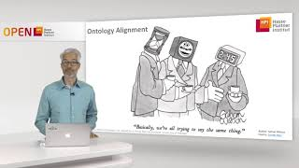
But what would a “mapping” look like?
Standards?
Specifying relationship types
Certainty
Formatting
Documentation for reuse
Licensing
Notes:
Ontology mapping is also called ontology “alignment.” There are different ways of aligning ontologies. For example, there’s linguistic alignment or “term matching.” Although intuitive, one of the pitfalls of this method is that people sometimes mean different things when using the same word. Another approach is structural mapping, which entails looking at a set of relationships in a network, and mapping terms based on similarity of nearby nodes. Automated semantic mapping tools are out-of-scope here, but worth exploring in the future.
I wondered what kinds of mapping standards and resources were available

Slide 17
A Simple Standard for Sharing Ontology Mappings (SSSOM)
Clear set of principles
Doesn’t favor any particular tool
Specific guidance, examples
Robust documentation, tutorials available
Mapping predicates pulled from OWL, SKOS, RDFS
Tutorial URL: https://mapping-commons.github.io/sssom/tutorial/
Paper citation: Matentzoglu, Nicolas, James P. Balhoff, Susan M. Bello, Chris Bizon, Matthew Brush, Tiffany J. Callahan, Christopher G. Chute et al. "A simple standard for sharing ontological mappings (SSSOM)." Database 2022 (2022).

Slide 18
Models in conversation
Medieval Manuscript Ontology
Europeana Data Model
MeMO
EDM
Digital Scriptorium Model
specializes
IMAGO
CRM
(is aligned with)
Index Medii Aevi Geographice Operum
Conceptual Reference Model
Notes:
Old notes: There are more, of course, but with limited time to explore semantic mapping I focused my efforts on these few and just dip my toe in. Other more generic ontologies came to mind (DC, FRBRoo, FOAF), but some of the above ontologies are sometimes already aligned (EDM for example) or reuse elements from these namespaces. So I decided to focus on these cultural heritage oriented ontologies. In the case of MeMO and IMAGO, both focus on manuscripts specifically, while EDM is a data aggregation model (much like DS) and CIDOC-CRM is a somewhat generic model that models temporality.

Slide 19
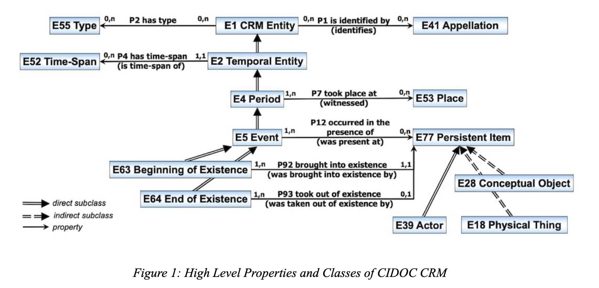
Conceptual Reference Model (CIDOC CRM v. 7.1.2)
Notes:
Broader, also has a more detailed class hierarchy/taxonomy, so contains a lot of part-whole and subsumption relationships. Since these are part of the semantics of the model, I tried to map DS terms to their most specific corollary in the CRM model, since these classes would inherit any logical implications and deductions based on their location in the hierarchy

Slide 20
Mapping highlight: DS to CRM

Slide 21
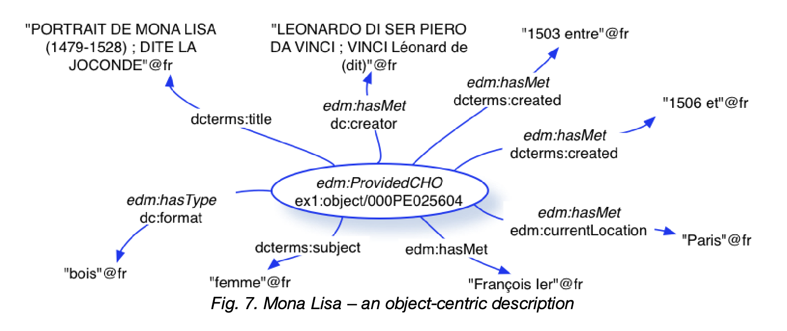
Europeana Data Model (EDM)

Slide 22
Mapping highlight: DS to EDM

Slide 23
EDM Definition
“This class includes the Cultural Heritage objects that Europeana collects descriptions about.”
Notes:
Primer specifically states that this class is for “real” objects, so yes.

Slide 24
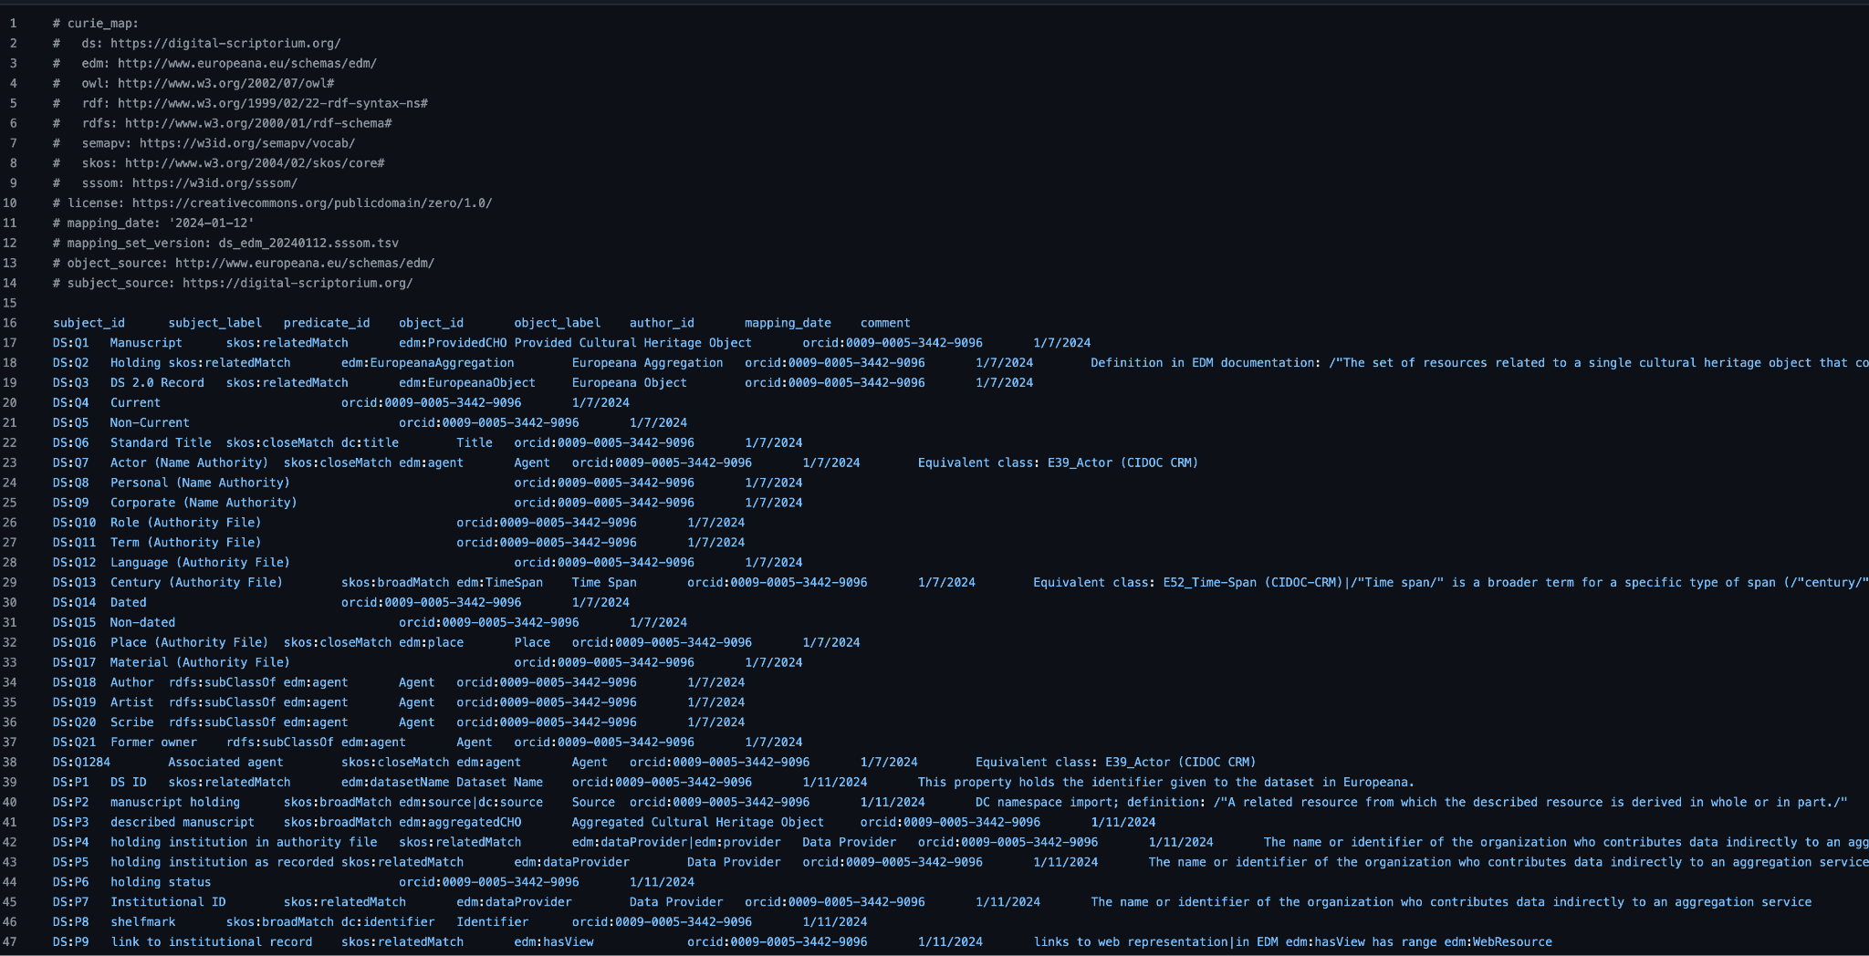
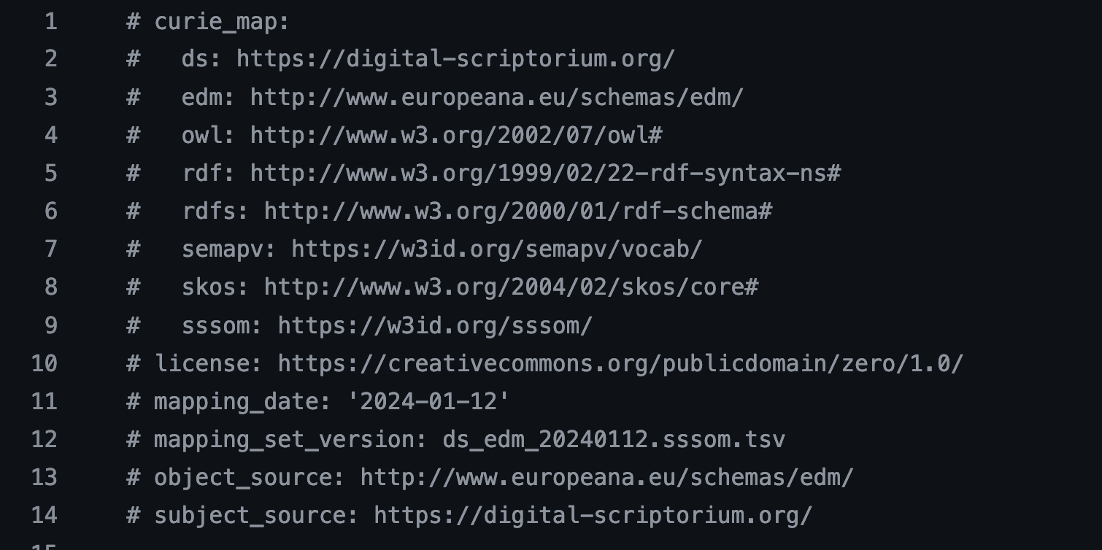
Snapshot of a semantic mapping: DS to EDM
Notes:
https://github.com/JadeMaurice/LEADING-Digital-Scriptorium/blob/main/DS_EDM_OntologyMapping.tsv

Slide 25
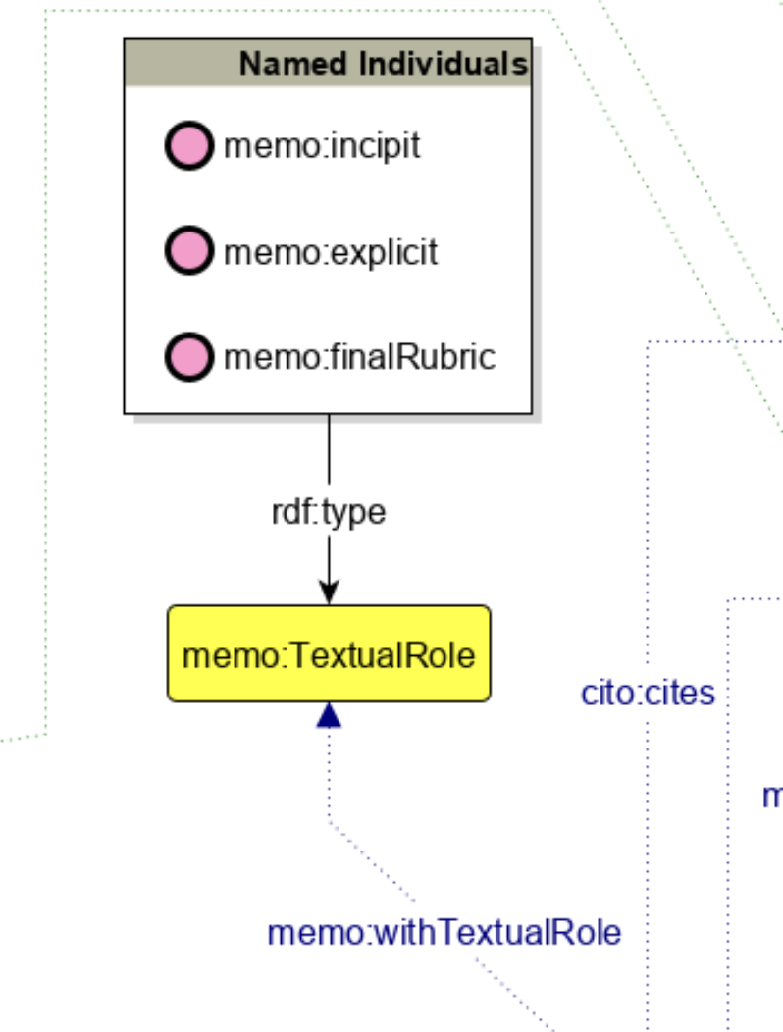
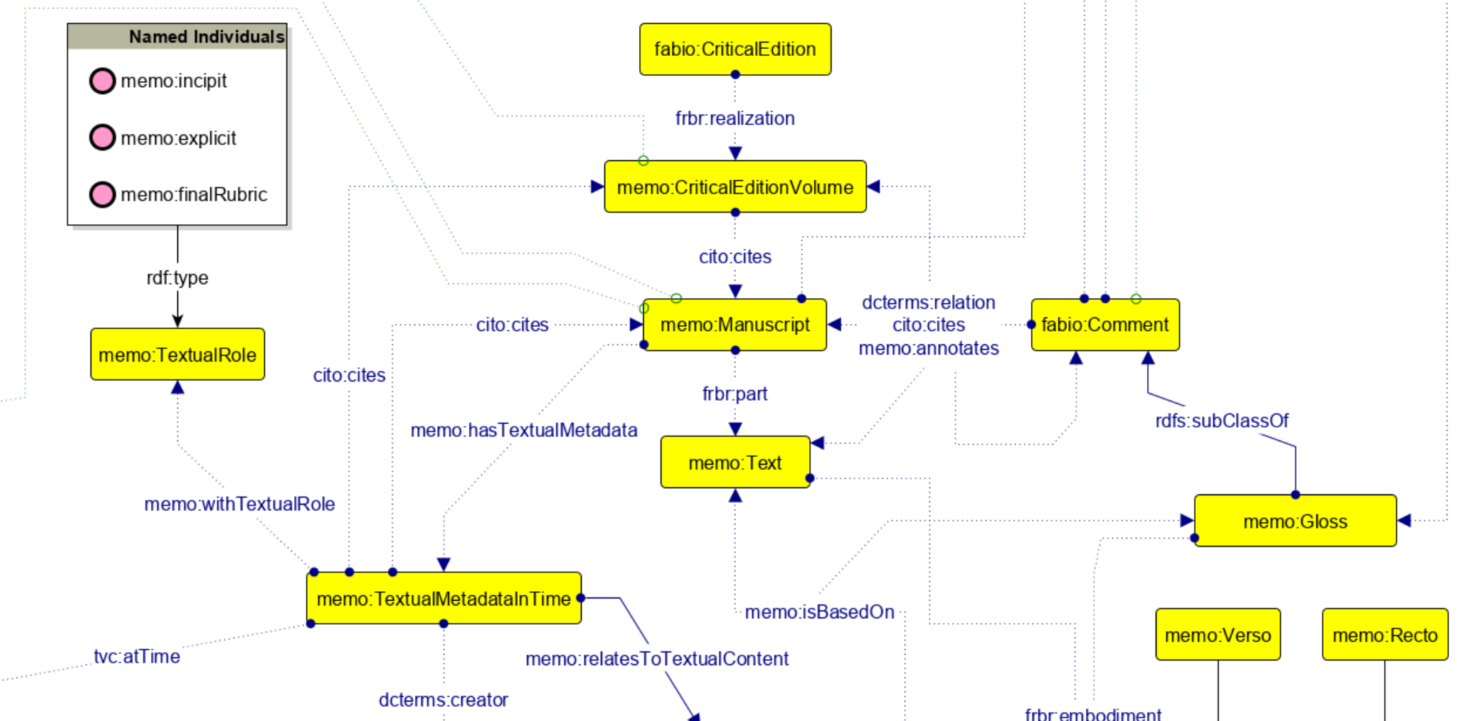
Medieval Manuscript Ontology (MeMO)
https://irnerio-opendata.github.io/memo/current/memo.html
Notes:
Model focused on intertextuality, annotation, and literary production.
LODE page

Slide 26
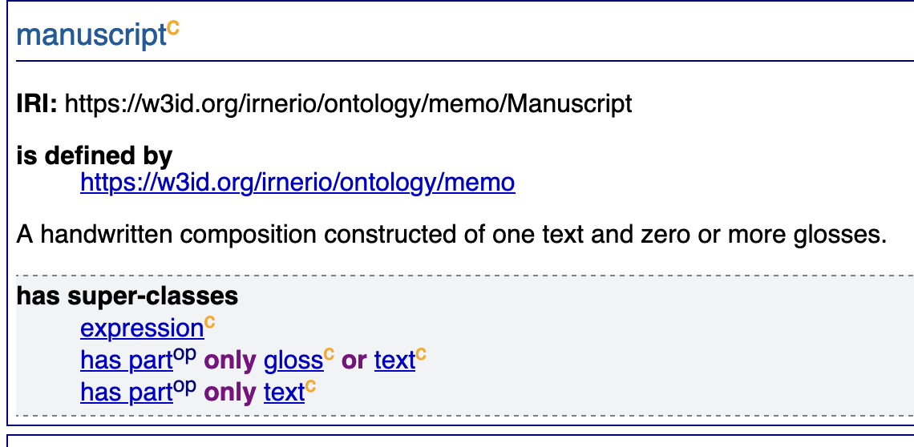
Mapping highlight: DS to MeMO

Slide 27
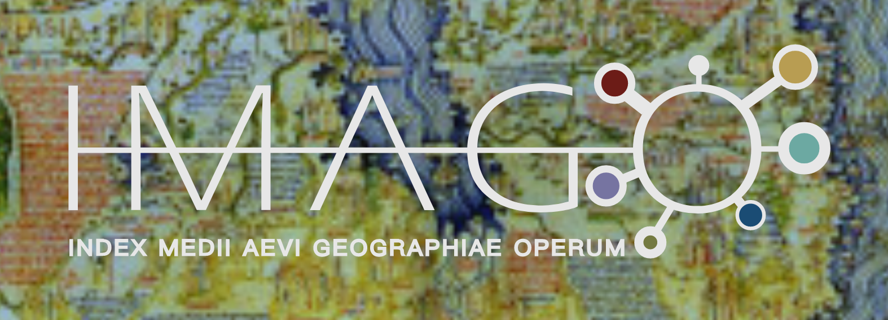
Index Medii Aevi Geographiae Operum (IMAGO)
Notes:
“Imago Mundi”
Latin geographical works

Slide 28
Mapping highlight: DS to IMAGO

Slide 29
Across the Data-Verse!
DC
CiTO
EDM
MeMO
Digital Scriptorium Model
FaBiO
CRM
FOAF
IMAGO
Notes:
Old notes: There are more, of course, but with limited time to explore semantic mapping I focused my efforts on these few and just dip my toe in. Other more generic ontologies came to mind (DC, FRBRoo, FOAF), but some of the above ontologies are sometimes already aligned (EDM for example) or reuse elements from these namespaces. So I decided to focus on these cultural heritage oriented ontologies. In the case of MeMO and IMAGO, both focus on manuscripts specifically, while EDM is a data aggregation model (much like DS) and CIDOC-CRM is a somewhat generic model that models temporality.

Slide 30
Sources and Further Reading
Allemang, Dean, James A Hendler, and Fabien Gandon. Semantic Web for the Working Ontologist : Effective Modeling for Linked Data, RDFS, and OWL (3rd edition). Association for Computing Machinery, 2020.
Antoniou, G, Paul Groth, Frank Van Harmelen, and Rinke Hoekstra. A Semantic Web Primer (3rd edition). MIT Press, 2012.
Bartalesi, Valentina, and Nicolo Pratelli. The IMAGO Ontology, July 12, 2021. https://imagoarchive.it/documentation/doc/index-en.html
Bartalesi, Valentina, Daniele Metilli, Nicolò Pratelli, and Paolo Pontari. "Towards a knowledge base of medieval and renaissance geographical Latin works: The IMAGO ontology." Digital Scholarship in the Humanities 37, no. 1 (2022): 34-50.
Barzaghi, Sebastian. The Medieval Manuscript Ontology (MeMO), March 3, 2023. https://irnerio-opendata.github.io/memo/current/memo.html
Barzaghi, Sebastian, Monica Palmirani, and Silvio Peroni. "Development of an ontology for modelling medieval manuscripts: the case of Progetto IRNERIO." Umanistica Digitale 9 (2020): 117-140.
CIDOC-CRM: https://www.cidoc-crm.org/sites/default/files/cidoc_crm_version_7.1.3.pdf
DuCharme, Bob. Learning SPARQL: querying and updating with SPARQL 1.1. " O'Reilly Media, Inc.", 2013.
EDM Definition: https://pro.europeana.eu/files/Europeana_Professional/Share_your_data/Technical_requirements/EDM_Documentation//EDM_Definition_v5.2.8_102017.pdf
Koho, Mikko, L. P. Coladangelo, Lynn Ransom, and Doug Emery. "A Wikibase Model for Premodern Manuscript Metadata Harmonization, Linked Data Integration, and Discovery." ACM Journal on Computing and Cultural Heritage (2023).
Matentzoglu, Nicolas, James P. Balhoff, Susan M. Bello, Chris Bizon, Matthew Brush, Tiffany J. Callahan, Christopher G. Chute et al. "A simple standard for sharing ontological mappings (SSSOM)." Database 2022 (2022).
Matentzoglu, Nicolas. “Introduction to Mapping Curation with SSSOM,” July 31, 2023 (latest release). https://mapping-commons.github.io/sssom/tutorial/
Shimizu, Cogan, Andrew Eells, Seila Gonzalez, Lu Zhou, Pascal Hitzler, Alicia Sheill, Catherine Foley, and Dean Rehberger. "Ontology Design Facilitating Wikibase Integration--and a Worked Example for Historical Data." arXiv preprint arXiv:2205.14032 (2022).
Staab, Steffen, and Rudi Studer, eds. Handbook on Ontologies (2nd edition). Springer, 2009.
Van Hooland, Seth, and Ruben Verborgh. Linked Data for Libraries, Archives and Museums: How to clean, link and publish your metadata. Facet publishing, 2014.

Slide 31
Thank you!
Contact information:
Jade Snelling, University Libraries at Virginia Tech
jss3838@vt.edu or snellingjade@gmail.com
You can also find me on LinkedIn or Github

